Slide 1

VR Lab for Enhanced Learning
Lightning Presentation
Prof. Aveek Dutta, Department of Electrical & Computer Engineering
Joren Cruz, Diego Tapia, Daniel Wang
Date: 11/21/23

Slide 2
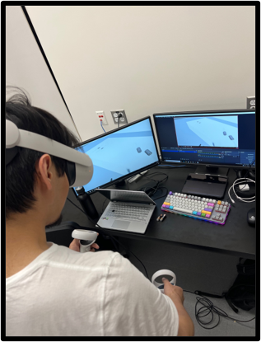
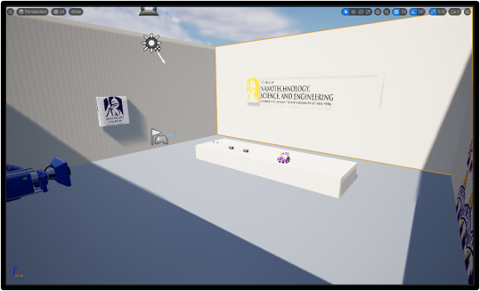
Introduction & Problem Statement
Everyone has different learning styles and introducing additional options will likely enhance student engagement.
Notes:
Our main objective is to support the idea that “everyone learns differently”. With the implementation of VR, we hope to create a fun and interactive learning tool that supplies fellow electrical engineers with a new method of gaining knowledge and learning new techniques, which can assist in classroom settings, and perhaps even workplace environments

Slide 3
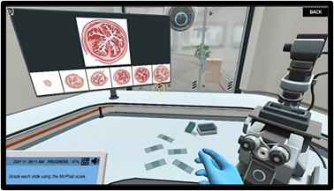
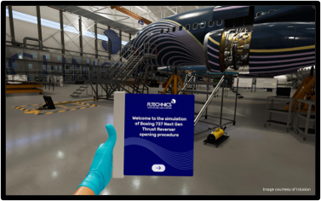
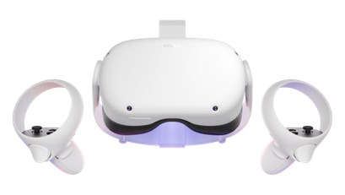
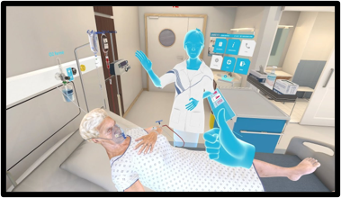
Background and Context
Hands-on (virtual) learning
Evolving landscape of education and technological advancements
Works effectively in other STEM fields
Notes:
This concept of this idea was given to us by our stakeholder, Professor Dutta. From his suggestions, we were able to hone in on wanting to develop in VR. The reason for picking VR over AR is primarily due to the fact that there are many other work environments in which it has already become a reliable and standard method of learning and practicing. Examples of such workplaces include STEM laboratory research, surgery simulations, patient care procedures, and aircraft maintenance engineering

Slide 4
System Demonstration
Notes:
Running environment in UE5
Top two right are interactions with the modules we built
Bottom two right are demonstrations that we can move around in the environment
Left shows the hardware setup we have to run the environment.
Laptops are not powerful enough to run the environment and Headset at the same time
Use of the workstation PCs in 192

Slide 5
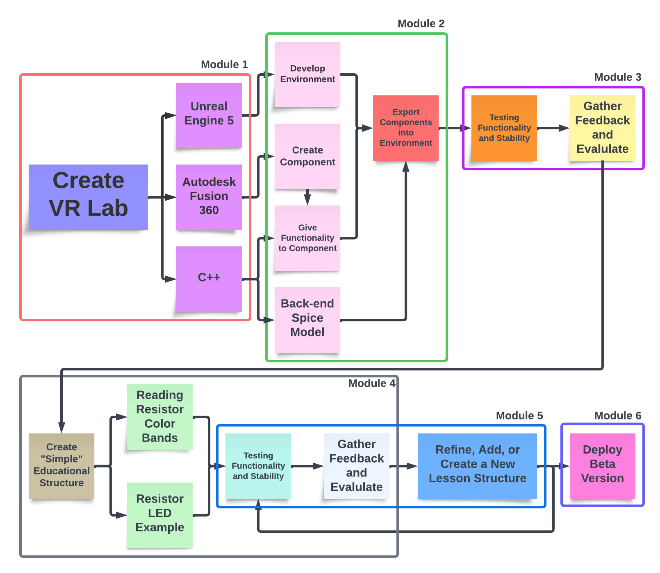
Goals for the Fall & Spring Semester
Notes:
Sectioned into 6 modules
“Thoroughly” walk through the first 3 with finer detail
Mention what we’ve accomplished this semester
Briefly go over module 4-6
Mention our goals in the Spring

Slide 6
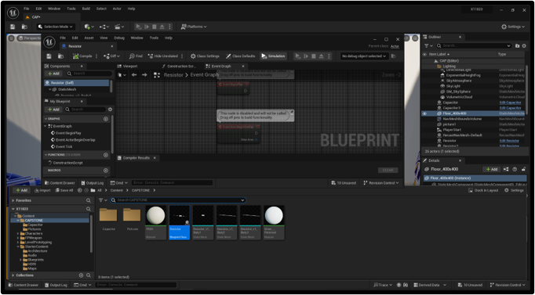
Design (Unreal Engine 5)
Notes:
Sneak peak into what we’re working with
UI for UE5
Lots of tabs and windows
For out application, mostly junk and clutter
Blueprint, nodes, Outliner, Content Library
Resistor files shown in content library

Slide 7
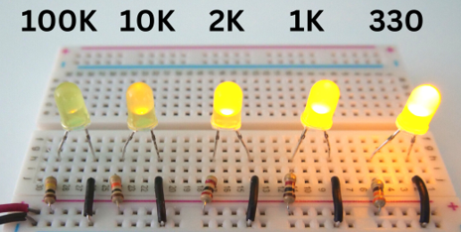
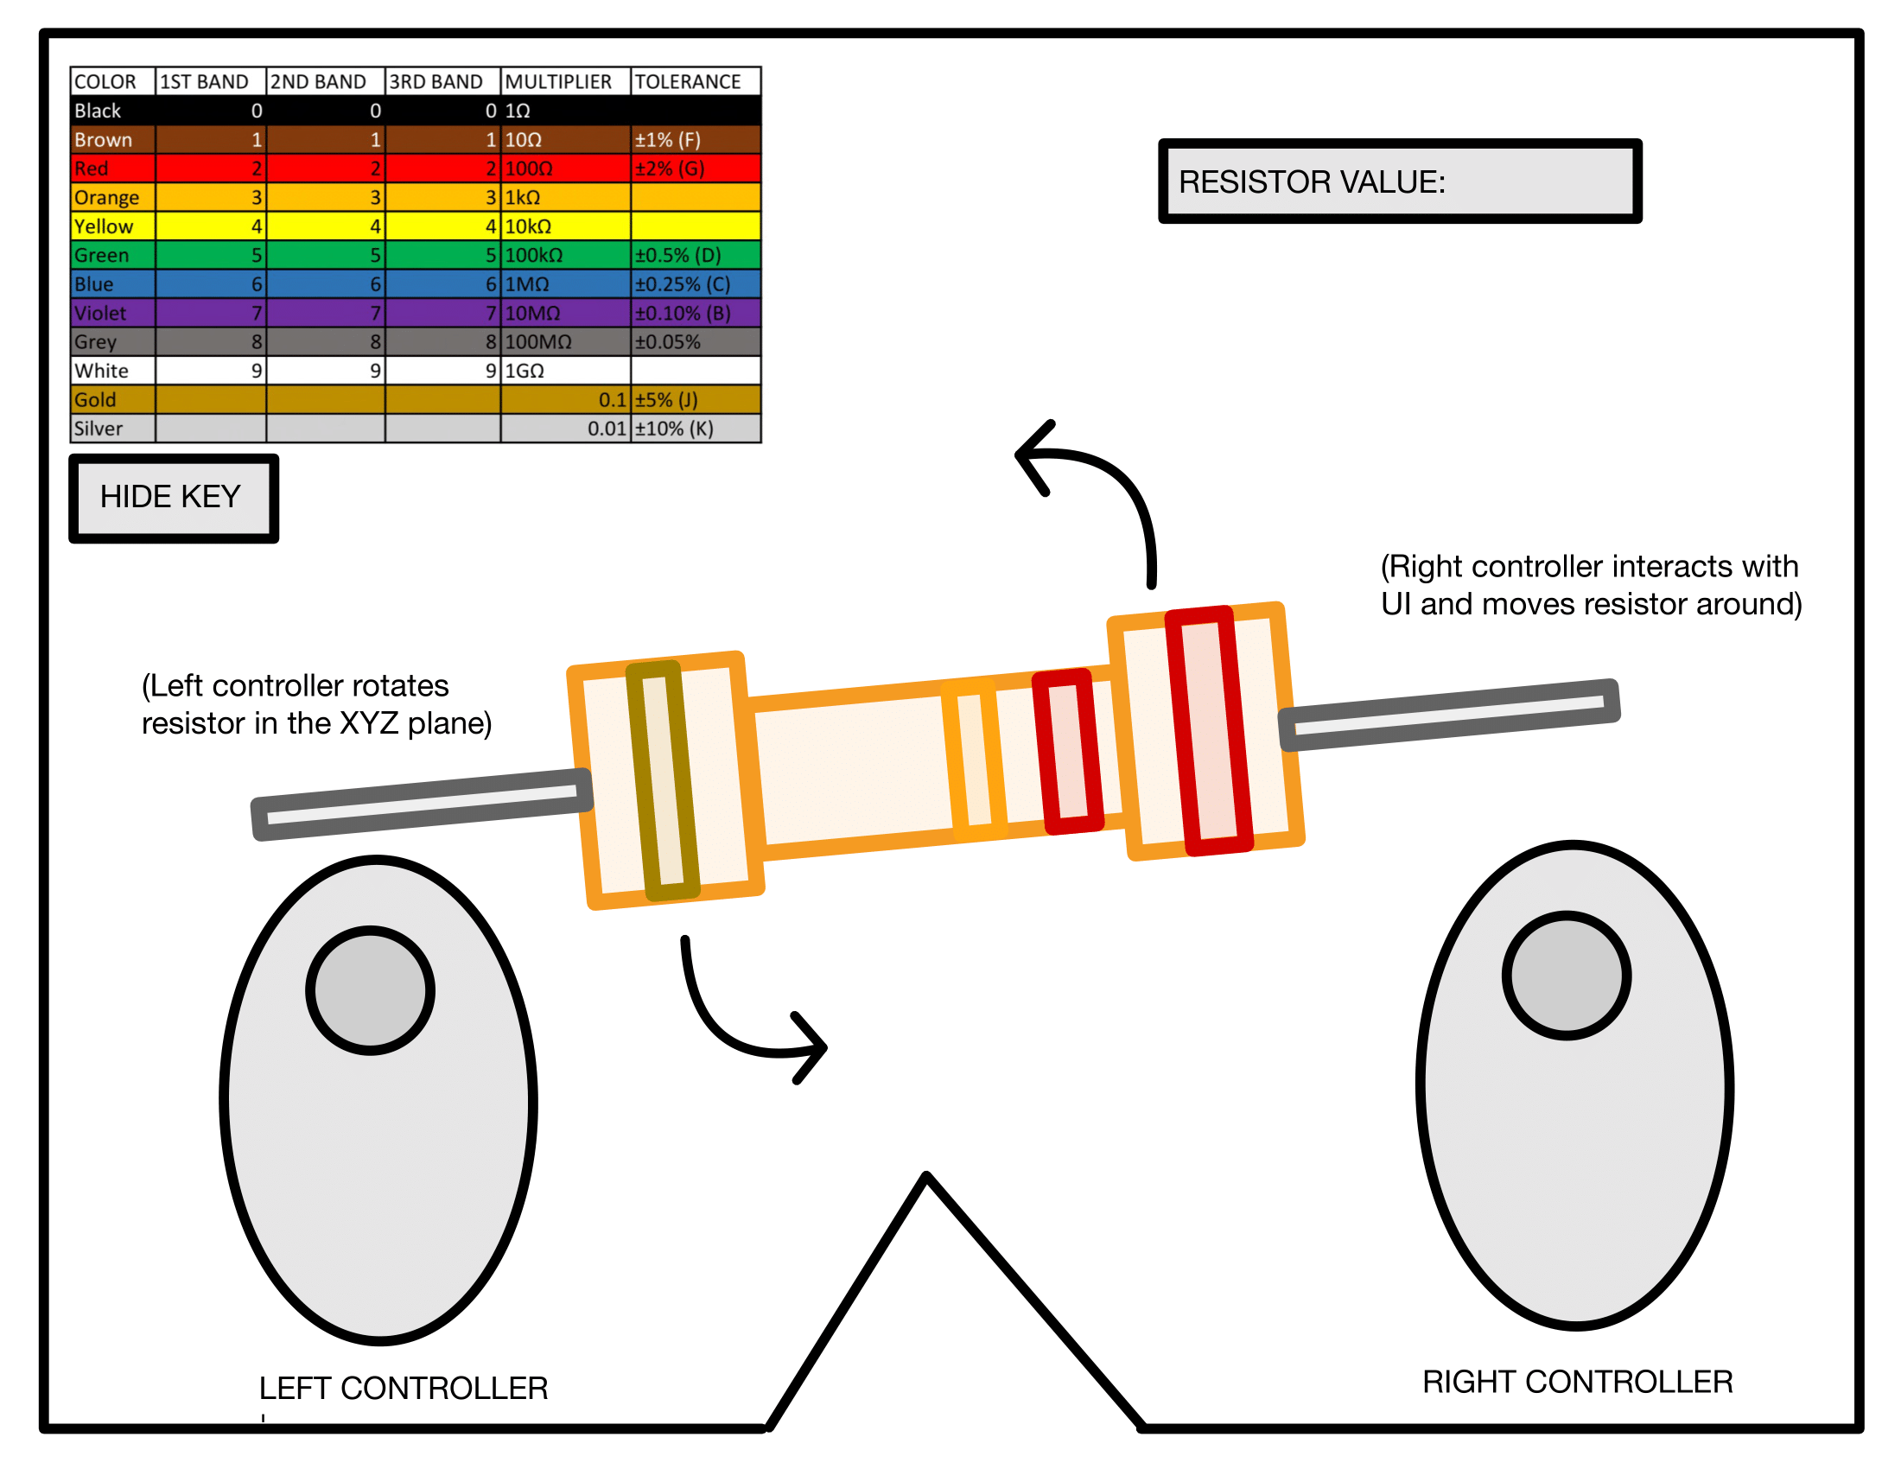
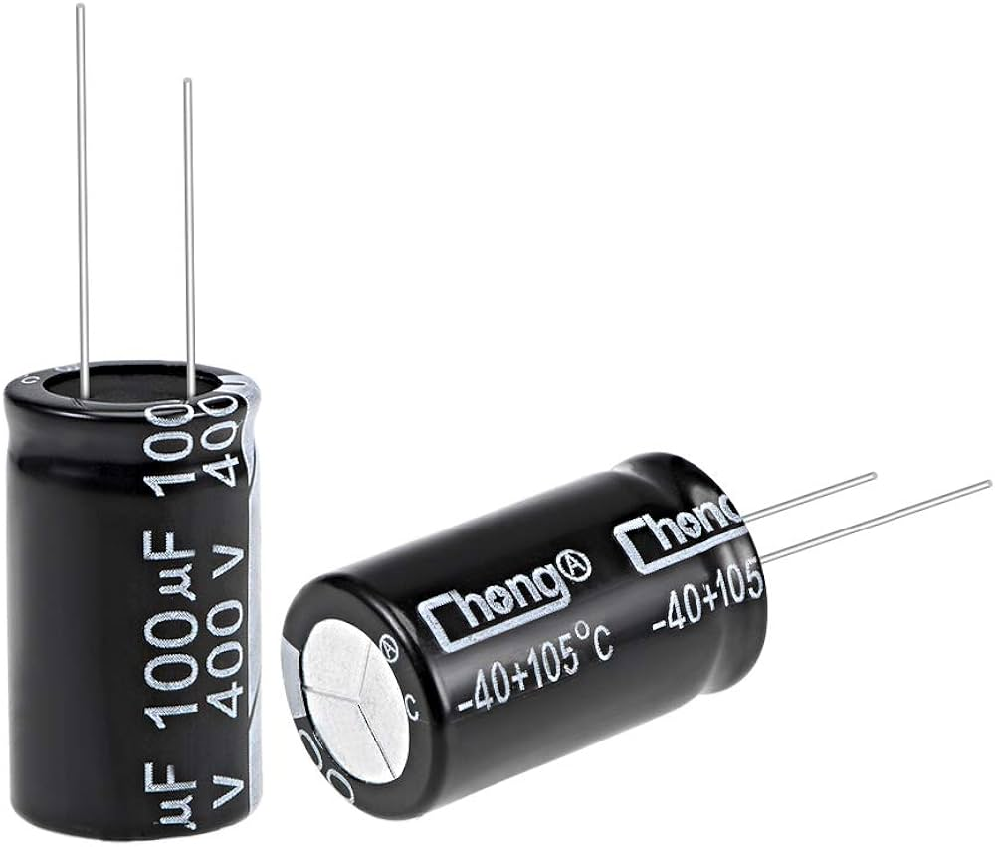
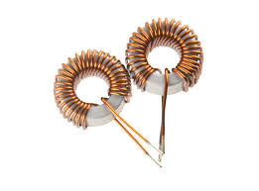
Design (Visual Prototype)
Notes:
Potential idea prototype
Interactable resistor with auto generated band values
Controllers allows for rotation and intractability with component
Simple HUD, resistor band table and area to enter the resistor value

Slide 8
Thank You!

